Slide 1

Plagiarism Detection Tools
Essential tools for maintaining academic integrity and ensuring original research

Slide 2




Industry-Standard Plagiarism Tools
iThenticate
Turnitin
Industry standard used by publishers through Crossref Similarity Check
Widely adopted in universities and conferences for comprehensive similarity reports
PlagScan / Unicheck / CopyLeaks
Grammarly Plagiarism Checker
Institutional-grade plagiarism detection systems
Quick author-level similarity verification tool

Slide 3

Tool URLs & Resources
Plagiarism Detection
Citation Management
iThenticate → ithenticate.com
Zotero → zotero.org
Mendeley → mendeley.com
Turnitin → turnitin.com
PlagScan → plagscan.com
Unicheck → unicheck.com
Grammarly → grammarly.com/plagiarism-checker

Slide 4

Journals Using These Tools
Major publishers implement iThenticate and Crossref Similarity Check before acceptance
Elsevier
Springer Nature
IEEE
Pre-publication plagiarism screening
Comprehensive similarity checks
Technical publication standards
Taylor & Francis
Wiley
Academic integrity verification
Quality assurance protocols
Many Q1/Q2 journals reject papers with similarity index >15%

Slide 5





Consequences of Plagiarism
Before Publication
Desk rejection or significant delays in peer review process
After Publication
Paper retraction or author blacklisting from future submissions
Institutional Action
Academic penalties, suspension, or termination
Reputation Loss
Severe difficulty publishing in future, damaged credibility as researcher

Slide 6

Reasons for Paper Retraction
A. Conference
B. Journal
Duplicate submission to multiple venues
Self-plagiarism or duplicate publication
Plagiarism or copied content
Data manipulation or falsified results
False or fabricated data
Ethical misconduct
Authorship disputes
Lack of ethical approval or permission

Slide 7

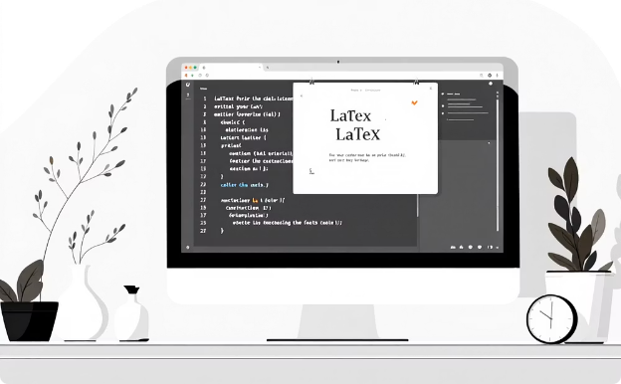
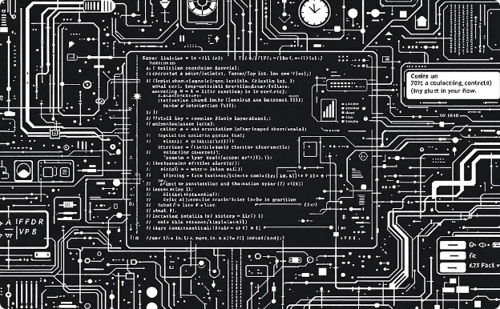
Citation Tools & Video Resources
Video 1: Drafting a Research Paper
Video 2: LaTeX Paper Preparation
Video 3: Advanced LaTeX Tools
Steps for writing and structuring papers using Zotero, Mendeley, and Google Scholar for citation insertion
Using Overleaf for professional formatting with IEEE/ACM templates and .bib citation imports
Algorithms, pseudocode, multi-column layouts, and collaboration via Overleaf with Git

Slide 8
Application to Your Research
Blockchain-Based E-Voting Paper Example
01
02
03
Manage References
Draft in LaTeX
Run Plagiarism Check
Use Zotero or Mendeley for blockchain and cryptography citations
Write paper in Overleaf using IEEE format templates
Use iThenticate before submission, ensure <15% similarity index
04
05
Cite Properly
Prepare Presentation
Reference every paper used in methodology and design sections
Create 10-12 slide PPT with proper references included

Slide 9
References
iThenticate. ithenticate.com
Advanced LaTeX Tutorial. youtu.be/j599UztgB1M
Turnitin. turnitin.com
Zotero. zotero.org
Drafting a Research Paper Hands-On. youtu.be/dnsZk1mtyiE
Overleaf. overleaf.com
COPE. publicationethics.org
Preparing a Research Paper in LaTeX. youtu.be/0CMmPBnbWow

